Slide 1
UNIT 4 Segments, Illumination models, colour models and shading
Syllabus
Segments: Introduction, Segment table, segment creation, closing, deleting, renaming, and visibility.
Illumination models: Light sources, ambient light, diffuse light, specular reflection, the Phong model, combined diffuse and specular reflections with multiple light sources.
Color Models: CIE Chromaticity Diagram, Color Gamut, RGB, CMY, YCbCr,HSVcolor models.
Shading Algorithms: Constant intensity shading, Halftone, Gourand and Phong Shading.

Slide 2
Segment
To view an entire image or a part of image with various attributes, we need to organize image information in a particular manner since existing structure of display file does not satisfy our requirements of viewing an image. To achieve this display, file is divided into Segments.
Dividing the display file into subparts is called as segments.
Each segment corresponds to a component and is associated with a set of attributes and image transformation parameters like scaling, rotation.
Presence of Segment allows :
Subdivision of picture.
Visualization of particular part of picture.
Scaling, rotation and translation of picture.

Slide 3
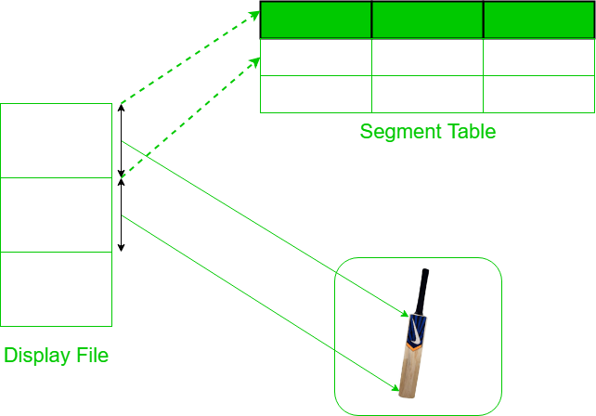

Slide 4
Types of Segments :
Posted Segment : When visible attribute of segment is set to 1, it is called Posted segment. This is included in active segment list.
Unposted Segment : When visible attribute of segment is set to 0, it is called Unposted segment. This is not included in active segment list.

Slide 5
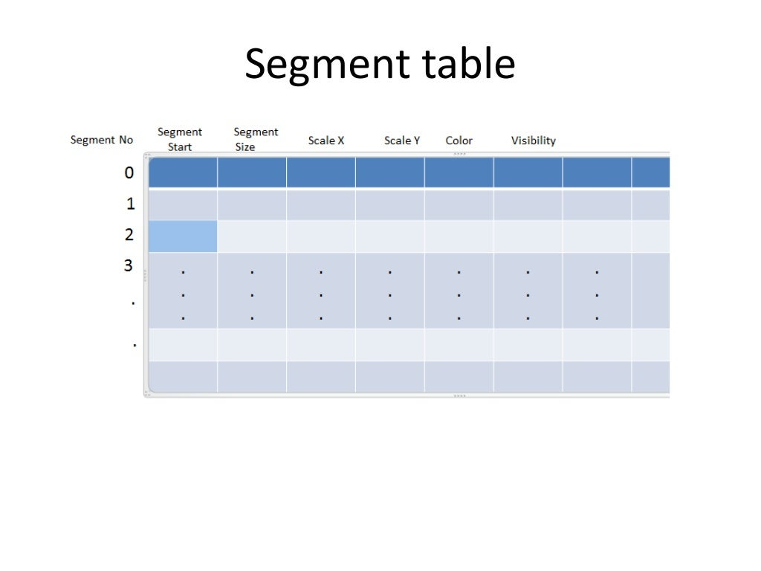

Slide 6
Segment Operations
Segment Creation :
Segment must be created or opened when no other segment is open, since two segments can’t be opened at the same time because it’s difficult to assign drawing instruction to particular segment.
The segment created must be given a name to identify it which must be a valid one and there should be no segment with the same name.
After this, we initialize items in segment table under our segment name and the first instruction of this segment is allocated at next free storage in display file and attributes of segments are initialized to default.

Slide 7
Algorithm :
If any segment is open, give error message : “Segment is still open” and go to step 8.
Read the name of the new segment.
If the segment name is not valid, give error message : “Segment name not a valid name” and go to step 8.
If given segment name already exists, give error message : “Segment name already exists in name list” and go to step 8.
Make next free storage area in display file as start of new segment.
Initialize size of new segment to 0 and all its attributes to their default values.
Inform that the new segment is now open.
Stop.

Slide 8
Closing a Segment :
After completing entry of all display file instructions, the segment needs to be closed for which it has to be renamed, which is done by changing the name of currently open segment as 0.
Now the segment with name 0 is open i.e. unnamed segment is open and if two unnamed segments are present in display file one needs to be deleted.

Slide 9
Algorithm :
If any segment is not open, give error message : “No segment is open now” and go to step 6.
Change the name of currently opened segment to any unnamed segment, lets say 0.
Delete any other unnamed segment instruction which may have been saved and initialize above unnamed segment with no instructions.
Make the next free storage area available in display file as start of the unnamed segment.
Initialize size of unnamed segment to 0.
Stop.

Slide 10
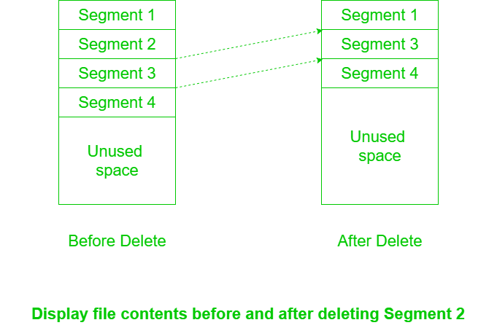
Deleting a Segment :
To delete a particular segment from display file, we must just delete that one segment without destroying or reforming the entire display and recover space occupied by this segment.
Use this space for some other segment.
The method to achieve this depends upon the data structure used to represent display file. In case of arrays, the gap left by deleted segment is filled by shifting up all the segments following it.

Slide 11
Renaming a Segment :
This is done to achieve Double Buffering i.e. the idea of storing two images, one to show and other to create, alter and for animation.
Algorithm :
If both old and new segment names are not valid, give error message : “Segment names are not valid names” and go to step 6.
If any of two segments is open, give error message : “Segments are still open” and go to step 6.
If new segment name given already exists in the display list, give error message : “Segment name already exists” and go to step 6.
The old segment table entry are copied into new position.
Delete the old segment.
Stop.

Slide 12
Advantages of using segmented display :
Segmentation allows to organize display files in sub-picture structure.
It allows to apply different set of attributes to different portions of image.
It makes it easier to the picture by changing/replacing segments.
It allows application of transformation on selective portions of image

Slide 13
Basic Illumination Models
Illumination model, also known as Shading model or Lightning model, is used to calculate the intensity of light that is reflected at a given point on surface. There are three factors on which lightning effect depends on:
Light Source : Light source is the light emitting source. There are three types of light sources:
Point Sources – The source that emit rays in all directions (A bulb in a room).
Parallel Sources – Can be considered as a point source which is far from the surface (The sun).
Distributed Sources – Rays originate from a finite area (A tubelight).
Light reflecting sources
All objects which are not emitting light are grouped under separate category, which is called as light reflecting sources.

Slide 14
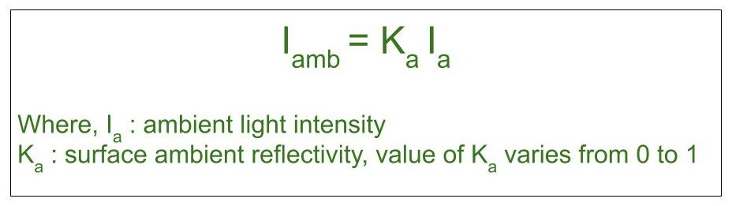
Ambient Illumination : Assume you are standing on a road, facing a building with glass exterior and sun rays are falling on that building reflecting back from it and the falling on the object under observation.
This would be Ambient Illumination. In simple words, Ambient Illumination is the one where source of light is indirect.
The light which is reflected from somewhere is called as background light or ambient light.

Slide 15
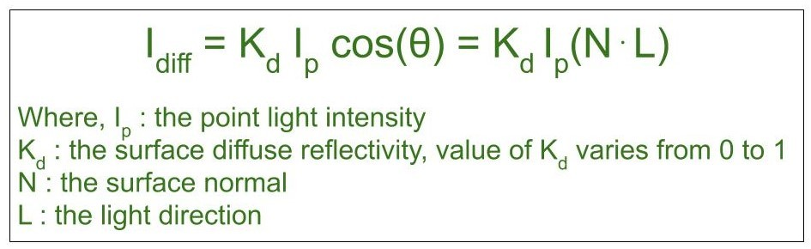
2. Diffuse Reflection :
When a light falls on any surface, it can be absorbed by the surface, while the rest will be reflected or retransmitted.
In this model, incoming light is scattered almost in all direction.
Diffuse reflection occurs on the surfaces which are rough or grainy. In this reflection the brightness of a point depends upon the angle made by the light source and the surface.
The ratio of light reflected from the surface to the total incoming light is called as the coefficient of reflection or reflectivity

Slide 16
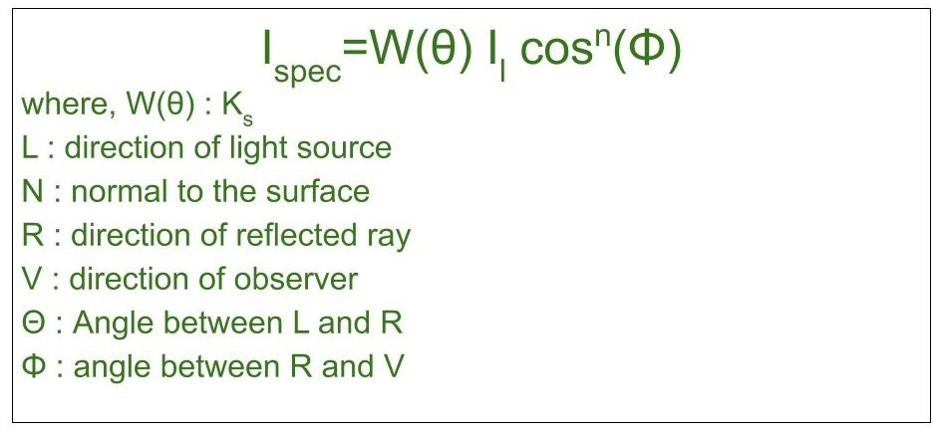
3. Specular Reflection : When light falls on any shiny or glossy surface most of it is reflected back, such reflection is known as Specular Reflection.
Specular reflection is a type of reflection which occurs at the surface of mirror.
Phong Model is an empirical model for Specular Reflection which provides us with the formula for calculation the reflected intensity I_{spec}:

Slide 17
Shading algorithms
Constant intensity shading
Gouraud shading
Phong shading
Halftone shading

Slide 18
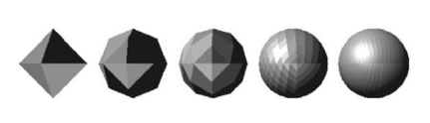
Constant shading
It is also called as Flat Shading.
For each polygon a single intensity is calculated and then with the same intensity value all points on that surface of the polygon are displayed.
This method is useful when we want to display the appearance of curved surfaces quickly.
It cannot handle specular reflection

Slide 19
Gourad Shading
Gourad shading is an example of intensity interpolation method.
renders a polygon surface by linear interpolating intensity value across the surface.
Intensity values for each polygon are coordinate with the value of adjacent polygons along the common edges, thus eliminating the intensity discontinuities that can occur in flat shading.
Each polygon surface is rendered with Gouraud Shading by performing the following calculations:
Determining the average unit normal vector at each polygon vertex.
Apply an illumination model to each vertex to determine the vertex intensity.
Linear interpolate the vertex intensities over the surface of the polygon.

Slide 20
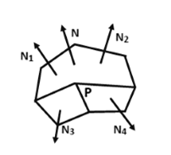
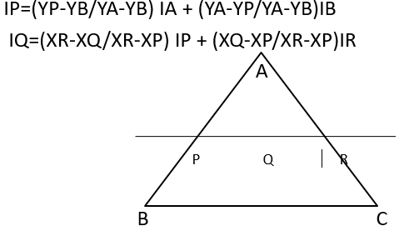

Slide 21
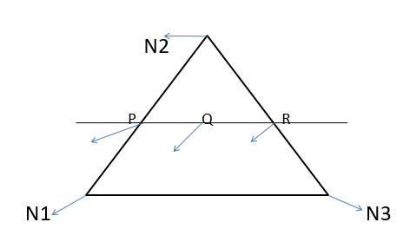
Phong shading
A more accurate method for rendering a polygon surface is to interpolate the normal vector and then apply the illumination model to each surface point.
It is also called as Phong Shading or normal vector Interpolation Shading.
Determine the average unit normal vector at each polygon vertex.
Linearly & interpolate the vertex normals over the surface of the polygon.
Calculate the pixel intensity of each scan line.

Slide 22
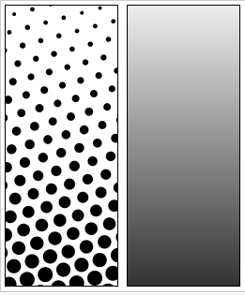

Halftone shading
Halftone is the reprographic technique that simulates continuous-tone imagery through the use of dots, varying either in size or in spacing, thus generating a gradient-like effect.
Where continuous-tone imagery contains an infinite range of
colors or greys, the halftone process reduces visual
reproductions to an image that is printed with only one
color of ink, in dots of differing size
(pulse-width modulation) or spacing (frequency modulation) or both.

